Slide 1
A New Test Vector Search Algorithm for a Single Stuck-at Fault using Probabilistic Correlation
Muralidharan Venkatasubramanian Vishwani D. Agrawal
Graduate Student James J. Danaher Professor
Department of Electrical and Computer Engineering
Auburn University

Slide 2
Outline
Purpose
Motivation
Background
Methodology
Results
Conclusion and Future work
References

Slide 3
Purpose
Given a stuck-at fault, find a test.
Specifically, find tests for hard to detect stuck-at faults.
Derive a quantum computing algorithm to search for test vectors.
Increased interests in areas of probabilistic computing algorithms.

Slide 4
Motivation
Fault detection problem is NP complete [Ibarra and Sahni, 1975; Fujiwara and Toida, 1982; Seroussi and Bshouty, 1988].
Various algorithms have been designed.
D Algorithm [Roth, 1966]
PODEM [Goel, 1981]
FAN [Fujiwara and Shimono, 1983]
Many others…
Nature of NP complete problem implies Increasing circuit size and complexity increases computation time.
NATW 2014

Slide 5
Background

Slide 6
Overview of Previous Research
Generation of test vectors a classic VLSI problem.
Tackled by numerous algorithms.
Developed algorithms improve search over random TPG.
Test sets derived from functional description of circuits can be too large [Akers, 1972 ; Reddy, 1973].
Use of weighted random test generators
Heuristics like input switching activity and weight assignment [Schnurmann et al., 1972].
Skewing input probability to attain maximum output entropy [Agrawal, 1981].

Slide 7
Overview (contd..)
Using spectral properties of successful vectors to generate new vectors [Yogi and Agrawal, 2006].
Implementing Hadamard matrices for Walsh functions.
Search limits when searching for unique test vectors of hard to detect faults.
Problem devolves back to NP hard problem.
Proposed solution uses probabilistic correlation among primary inputs.
Skew the search in the test vector space.
NATW 2014

Slide 8
Methodology

Slide 9
Algorithm Principle
Correlation present between input test vectors [Akers, 1972].
Because we are testing hard-to-detect faults, we generally have many trial vectors that do not work.
Conjecture is to find test vectors with properties not similar to the preciously found vectors.
Ignore vectors with properties similar to known unsuccessful test vectors.
Use opposite correlation to extract the likely test vectors.
Skew the search in the test vector space for the correct test vector.

Slide 10
Principle (contd..)
Quantify correlations in an n x n probability matrix.
n is the no. of primary inputs.
Diagonal represents independent probability of ‘0’ or ‘1’ at primary input.
An off-diagonal entry represents conditional probability of ‘0’ or ‘1’ at other inputs given a state at the chosen primary input.
Correlation matrix contains information from unsuccessful test vectors.

Slide 11
Algorithm Steps
c17 benchmark circuit
5 primary inputs
Initially, apply random vectors to the CUT so as to build an initial table of unsuccessful vectors.

Slide 12
Steps (contd..)
Initial Test vectors derived from random TPG
0 1 1 0 0
1 0 0 0 1
1 0 1 1 0
Probability Correlation Matrix
A | 0.66 | 0 | 0.50 | 1 | 1
B | 0 | 0.33 | 0.50 | 0 | 0
C | 0.50 | 1 | 0.66 | 1 | 0
D | 0.50 | 0 | 0.50 | 0.33 | 0
E | 0.50 | 0 | 0 | 0 | 0.33
Input signal probability
Input signal probability conditional to corresponding input being ‘1’

Slide 13
Steps (contd..)
A | B | C | D | E
0.66 | 0 | 0.5 | 0.5 | 0.5
0 | 1 | x | x | x
0 | 1 | 0 | 0 | 0
0 | 1 | 0 | 0 | 1
0 | 1 | 0 | 1 | 0
0 | 1 | 0 | 1 | 1
0 | 1 | 1 | 0 | 0
0 | 1 | 1 | 0 | 1
0 | 1 | 1 | 1 | 1
A | 0.40 | 0 | 0.33 | 0.33 | 0.50
B | 0 | 0.60 | 0.66 | 0.66 | 0.50
C | 0.50 | 0.66 | 0.60 | 0.66 | 0.50
D | 0.50 | 0.66 | 0.66 | 0.60 | 0.50
E | 0.50 | 0.33 | 0.33 | 0.33 | 0.40
Add the two derived test vectors to the original set and recalculate the matrix
Recalculated Probability Correlation Matrix

Slide 14
Steps (contd..)
Final test vector set:
0 1 1 0 0
1 0 0 0 1
1 0 1 1 0
0 1 0 1 0
0 1 1 1 1
1 0 0 0 0
A | B | C | D | E
0 | 0.60 | 0.66 | 0.66 | 0.33
1 | 0 | 0 | 0 | x
1 | 0 | 0 | 0 | 0
1 | 0 | 0 | 0 | 1
Final test vector

Slide 15
Results

Slide 16
10 input AND gate (Random TPG)
Mean = 566
Average no. of iterations needed to find a single stuck-at fault using a random test generator

Slide 17
10 input AND gate (Weighted Random)
Mean = 26
Average no. of iterations needed to find a single stuck-at fault using a weighted random test generator [Agrawal, 1981]

Slide 18
10 input AND gate (Correlation Algorithm)
Mean = 9
Average no. of iterations needed to find a single stuck-at fault using the proposed correlation algorithm

Slide 19
Benchmark circuits
C17 benchmark circuit
Had no hard to detect stuck-at faults
Proposed correlation algorithm took ~24-30 iterations to detect 12 faults (3 vectors) with worst case of 44 iterations.
FastScan needed 64 iterations with worst case of 128 iterations.
C492 benchmark circuit (27 primary inputs)
Fault no. | Correlation Algorithm iterations | FastScan iterations | Average iterations needed
1 | 3180 | Could not compute | 2²⁷/2 = 2²⁶
2 | 1864
3 | 3179
4 | 1865

Slide 20
Future Work
Optimizing the algorithm for more efficiency.
Running simulations on all ISCAS benchmark circuits.
Comparing efficiency with other contemporary and deterministic algorithms to prove superiority.
Weighted random generators
Spectral test generators
Anti-random test generators [Malaiya, 1995]
Foray into quantum algorithms (future vision).

Slide 21
Conclusion
Demonstrated proof of concept of new probabilistic correlation algorithm.
Shown resilience compared to previously published output entropy based algorithm.
Initial results show the superiority of algorithm over FastScan for hard to detect stuck-at faults.
Vision of future direction research and identifying steps towards a quantum algorithm.

Slide 22
References
[1] O. H. Ibarra and S. Sahni, “Polynomially complete fault detection problems,” IEEE Trans. Computers, vol. 24, no. 3, pp. 242–249, 1975.
[2] H. Fujiwara and S. Toida, “The complexity of fault detection problems for combinational logic circuits,”IEEE Transactions on Computers, vol. 100, no. 6, pp. 555–560, 1982.
[3] G. Seroussi and N. H. Bshouty, “Vector sets for exhaustive testing of logic circuits,” IEEE Transactions on Information Theory, vol. 34, no. 3, pp. 513–522, 1988.
[4] J. P. Roth, “Diagnosis of automata failures: A calculus and a method,” IBM Journal of Research and Development, vol. 10, no. 4, pp. 278–291, 1966.
[5] P. Goel, “An implicit enumeration algorithm to generate tests for combinational logic circuits,” IEEE Transactions on Computers, vol. 100, no. 3, pp. 215–222, 1981.
[6] H. Fujiwara and T. Shimono, “On the acceleration of test generation algorithms,” IEEE Transactions on Computers, vol. 100, no. 12, pp. 1137–1144, 1983.

Slide 23
References (contd..)
[7] S. B. Akers, “Universal test sets for logic networks,” in IEEE Conference Record of 13th IEEE Annual Symposium on Switching and Automata Theory, 1972, pp. 177–184.
[8] S. M. Reddy, “Complete test sets for logic functions,” IEEE Transactions on Computers, vol. 100, no. 11, pp. 1016–1020, 1973.
[9] H. D. Schnurmann, E. Lindbloom, and R. G. Carpenter, “The weighted random test-pattern generator,” IEEE Transactions on Computers, vol. 100, no. 7, pp. 695–700, 1975.
[10] V. D. Agrawal, “An information theoretic approach to digital fault testing,” IEEE Transactions on Computers, vol. 30, no. 8, pp. 582–587, 1981.
[11] N. Yogi and V. D. Agrawal, “Spectral RTL test generation for gate-level stuck-at faults,” in Proc. 15th Asian Test Symposium, IEEE, 2006, pp. 83–88.
[12] Y. K. Malaiya, “Antirandom testing: Getting the most out of black-box testing,” in Proc. Sixth IEEE International Symposium on Software Reliability Engineering, 1995, pp. 86–95.

Slide 24
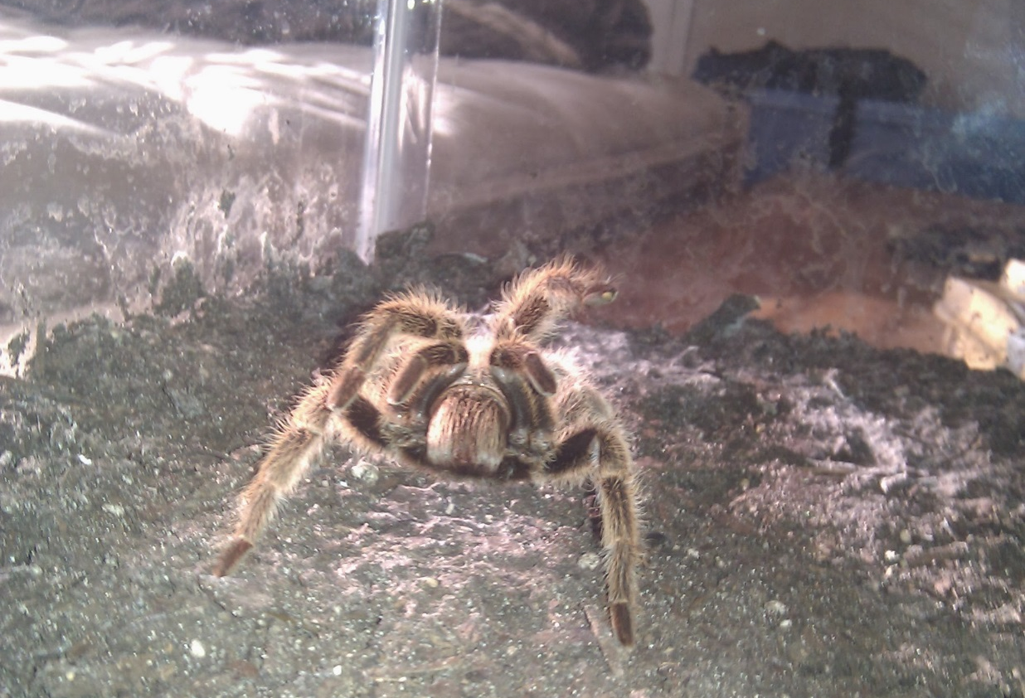
Questions??
Thank You!!!

